Slide 1
Game Playing by
Seyed Abolghasem Mirroshandel mirroshandel@gmail.com
mirroshandel@gmail.com
Notes:
Fall 98

Slide 2
Outline
Two-player games
Minmax search algorithm
Alpha-Beta pruning
Games with chance
State of the art
mirroshandel@gmail.com

Slide 3
Two-player games: motivation
Previous heuristics and search procedures are only useful for single-player games
  no notion of turns: one or more cooperative agents
  does not take into account adversarial moves
Games are ideal to explore adversarial strategies
  well-defined, abstract rules
  most formulated as search problems
  really hard combinatorial problems -- chess!!
mirroshandel@gmail.com

Slide 4
Two-player games
Search tree for each player remains the same
  Even levels i are moves of player A
  Odd levels i+1 are moves of player B
Each player searches for a goal (different for each) at their level
Each player evaluates the states according to their heuristic function
A’s best move brings B to the worst state
A searches for its best move assuming B will also search for its best move
mirroshandel@gmail.com

Slide 5
MinMax search strategy
Search for A’s best next move, so that no matter what B does (in particular, choosing its best move) A will be better off
At each step, evaluate the value of all descendants: take the maximum if it is A’s turn, or the minimum if it is B’s turn
We need the estimated values d moves ahead
  generate all nodes to level d (BFS)
  propagate Min-Max values up from leafs
mirroshandel@gmail.com

Slide 6
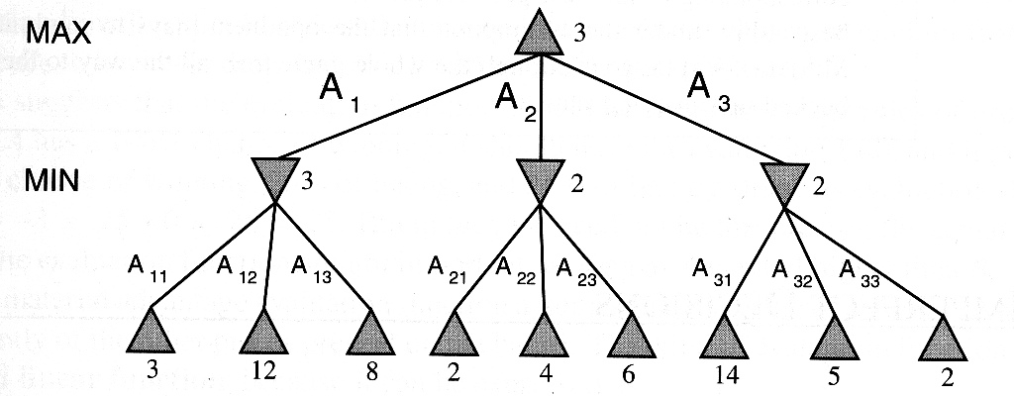
Illustration of MinMax principle
mirroshandel@gmail.com

Slide 7
MinMax evaluation function
function MinMax-Decision(game) returns an operator
for each op in Operator[game] do
Value[op] := MinMax-Value(Apply(op,game),game)
end
return the op with the highest Value[op]
function MinMax-Value(state,game) returns an utility value
if Terminal-Test[game](state) then
return Utility[game](state)
else if MAX’s turn
return the highest MinMax-Value of Successors(state)
else (MIN’s turn)
return the lowest MinMax-Value of Successors(state)
end
mirroshandel@gmail.com

Slide 8
MinMax algorithm
while actual node is not a winning state do
1. Generate the game tree to level m from actual
2. Apply the utility function to the leafs
3. Propagate the values of each node up by layers, according to the MinMax principle, up to the root
4. Choose the action with the maximum value at the root (minmax decision) and move to next state (actual := Apply(op,game)
end Complexity: O(b^{m})
mirroshandel@gmail.com

Slide 9
MinMax search on Tic-Tac-Toe
Evaluation function Eval(n) for A
  infinity if n is a win state for A (Max)
  -infinity if n is a win state for B (Min)
  (# of 3-moves for A) -- (# of 3-moves for B) a 3-move is an open row, column, diagonal
A is X
Eval(s) = 6 - 4
mirroshandel@gmail.com

Slide 10
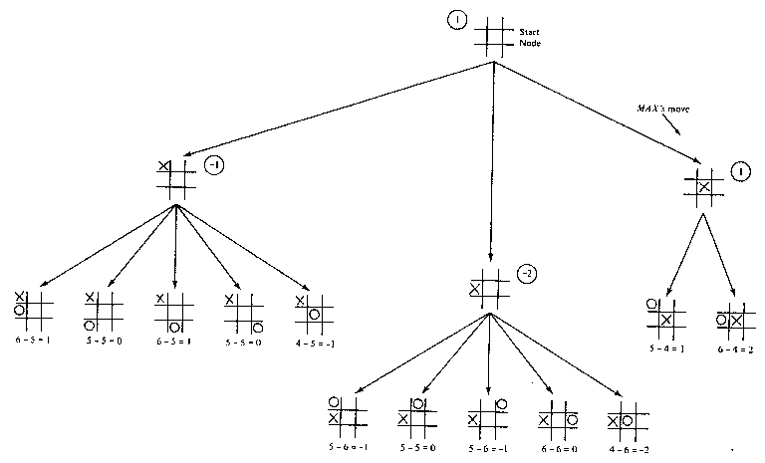
Tic-Tac-Toe MinMax search, d=2
mirroshandel@gmail.com

Slide 11
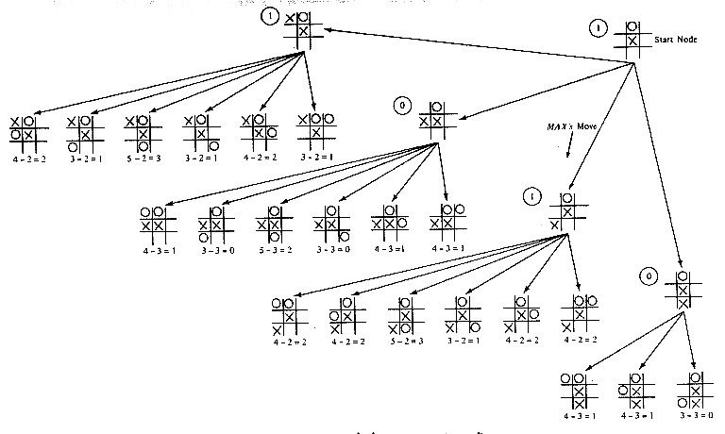
Tic-Tac-Toe MinMax search, d=4
mirroshandel@gmail.com

Slide 12
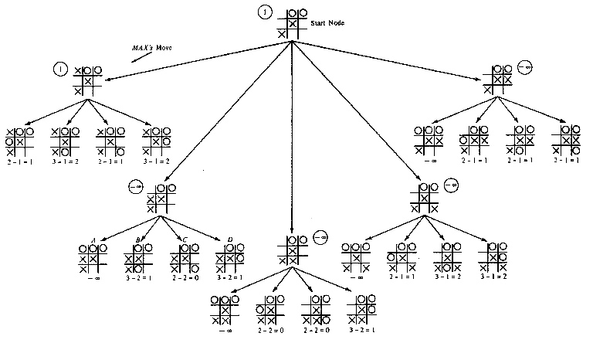
Tic-Tac-Toe MinMax search, d=6
mirroshandel@gmail.com

Slide 13
MinMax search
m is the look-ahead factor: how many moves ahead of the current one we compute.
MinMax optimal if d <= m (d is depth of solution)
IDS can be adapted to save memory.
Horizon problem: node n can be the best at level m but disastrous at level m+1!
Quiescent states: small variations of evaluation function values. Explore nonquiescent states further.
mirroshandel@gmail.com

Slide 14
Alpha-Beta Prunning
A disadvantage of MinMax search is that it has to expand every node in the subtree to depth m. Can we make a correct MinMax decision without looking at every node?
We want to prune the tree: stop exploring subtrees for which their value will not influence the final MinMax root decision
Observation: all nodes whose values are greater (smaller) that the current minimum (maximum) need not be explored!
mirroshandel@gmail.com

Slide 15
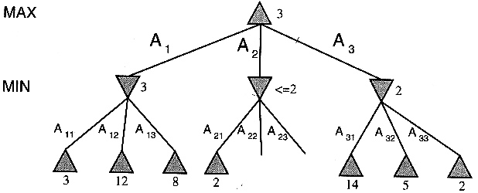
Alpha-Beta prunning
mirroshandel@gmail.com

Slide 16
Alpha-Beta search cutoff rules
Keep track and update two values:
  alpha is the lowest value in the MAX path so far
  beta is the highest value in the MIN path so far
Rule: do not expand node n when beta <= alpha
  for MIN node return alpha
  for MAX node return beta
In the worst case, no cut-off. The complexity is O(b^{d})
mirroshandel@gmail.com

Slide 17
Alpha-Beta prunning
function Max-Value(state,game,alpha,beta) returns
minmax value of state
if Cutoff-Test(state) then return Eval(state)
for each s in Successor(state) do
alpha := Min(alpha,Min-Value(s, game,alpha,beta)
if beta <= alpha then return beta
end; return alpha
function Min-Value(state,game,alpha,beta) returns
minmax value of state
if Cutoff-Test(state) then return Eval(state)
for each s in Successor(state) do
beta := Max(beta,Max-Value(s, game,alpha,beta)
if beta <= alpha then return alpha
end; return beta
mirroshandel@gmail.com

Slide 18
Practical extensions
Evaluation function measures expected utility of a move. Like the heuristic function before
Cut-off criteria by “goodness”, not by depth: selective deepening
Quiescent states expansion
Horizon problem
Precompiled evaluations for the beginning and end of the game
mirroshandel@gmail.com

Slide 19
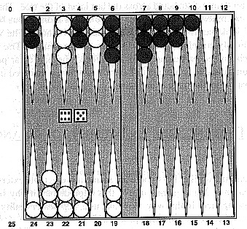
Games with chance
Backgammon board
mirroshandel@gmail.com

Slide 20
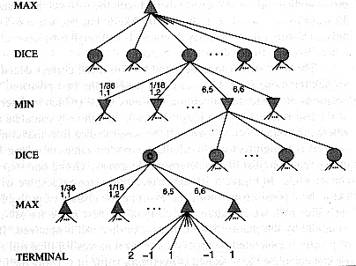
Search tree with probabilities
mirroshandel@gmail.com

Slide 21

Games with chance
chance nodes: nodes where chance events happen (rolling dice, flipping a coin, etc)
Evaluate expected value by averaging outcome probabilities:
  C is a chance node
  P(d_{i}) probability of rolling d_{i} (1,2, …, 12)
  S(C,d_{i}) is the set of positions generated by applying all legal moves for roll d_{i} to C
mirroshandel@gmail.com

Slide 22
State-of-the art game programs
Championship programs for Checkers, Chess, Backgammon, Othello, Go, and more
Combination of brute force search, heuristics, and game database
Some programs attempt to improve or learn the heuristic function by comparing its estimates with actual outcomes
Some programs attempt to discover rules and heuristic functions
mirroshandel@gmail.com

